Slide 1
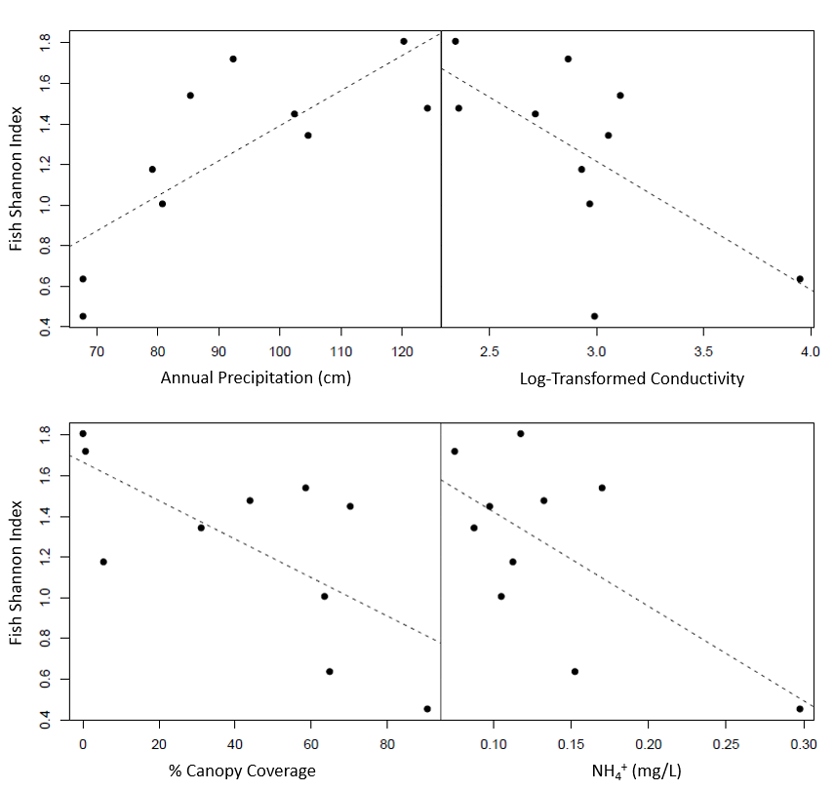
SI_{fish}= 3.11 - 0.63*log(Cnd)
R² = 0.41
p-value < 0.05
SI_{fish}= -0.34 + 0.02*AP
R² = 0.60
p-value = 0.01
SI_{fish}= 1.89 - 4.65*NH4
R² = 0.44
p-value = 0.04
SI_{fish}= 1.67 - 0.44*Cpy
R² = 0.47
p-value = 0.03

Slide 2
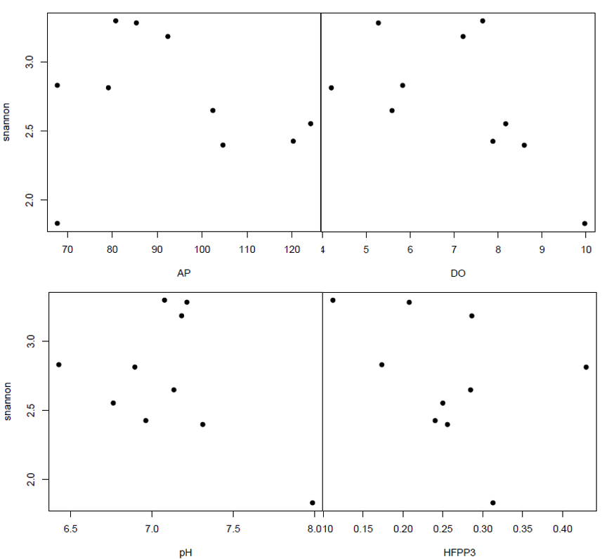
Benthic Invertebrate
Shannon Index
4
Precipitation (cm/yr)
Dissolved Oxygen (mg/L)
Benthic Invertebrate
Shannon Index
pH
High Flow Pulse Percent 3x

Slide 3
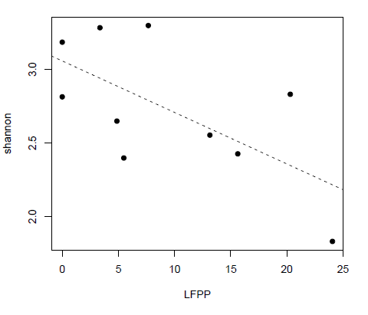
Benthic Invertebrate
Shannon Index
SI_{invert}= 3.06 – 0.03*LFPP
R² = 0.41
p-value < 0.05
Low Flow Pulse Percent

Slide 4
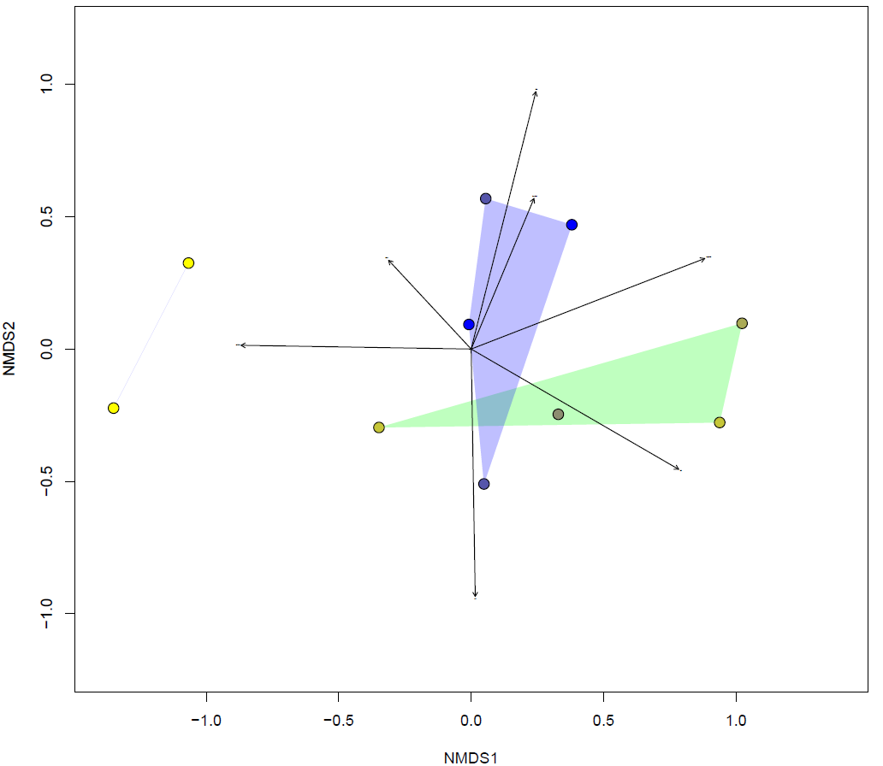
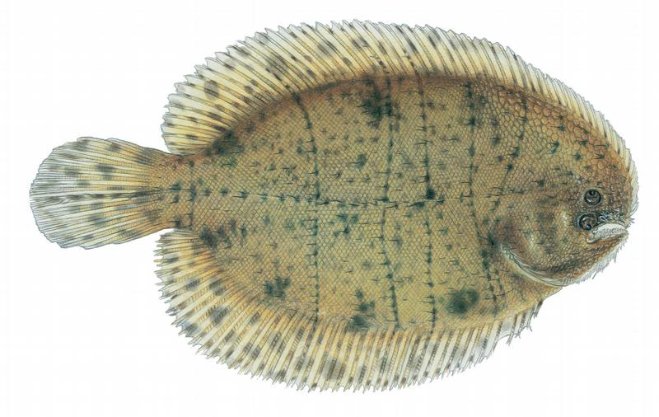
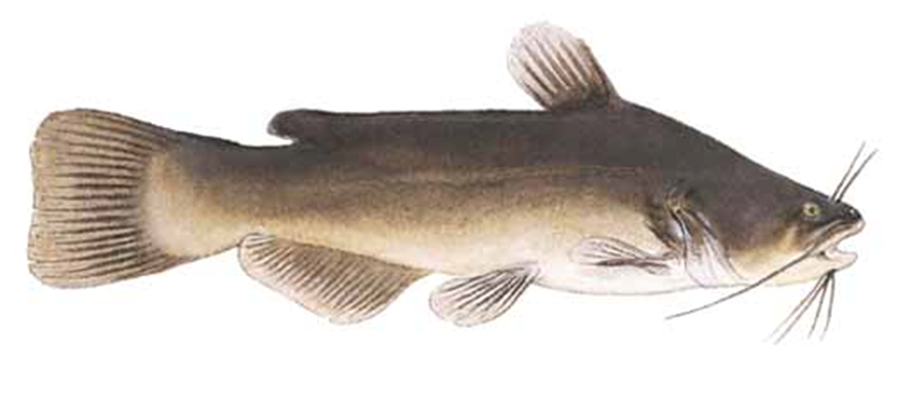
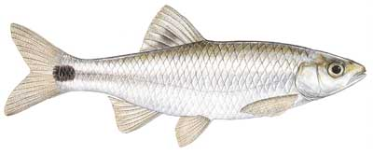
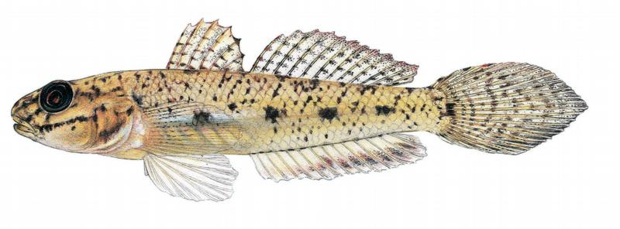
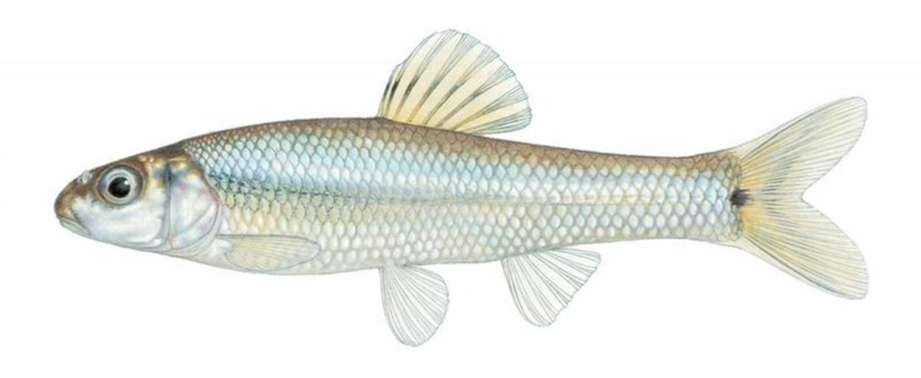
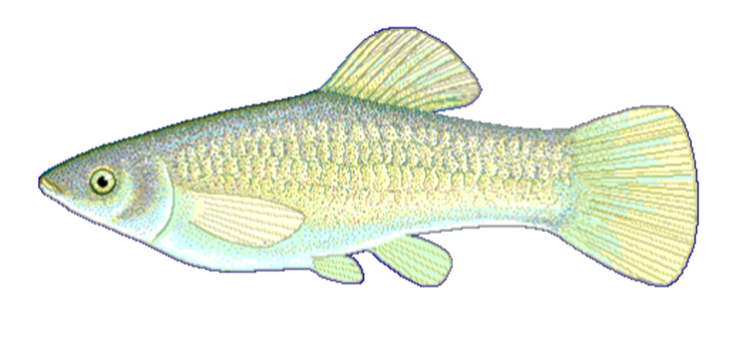
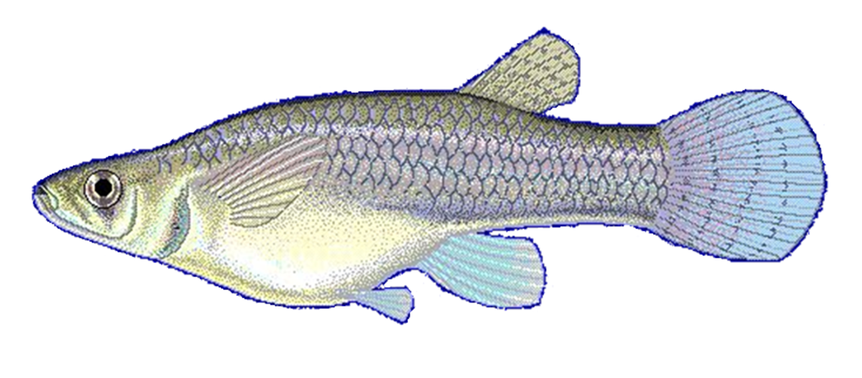
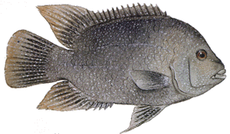
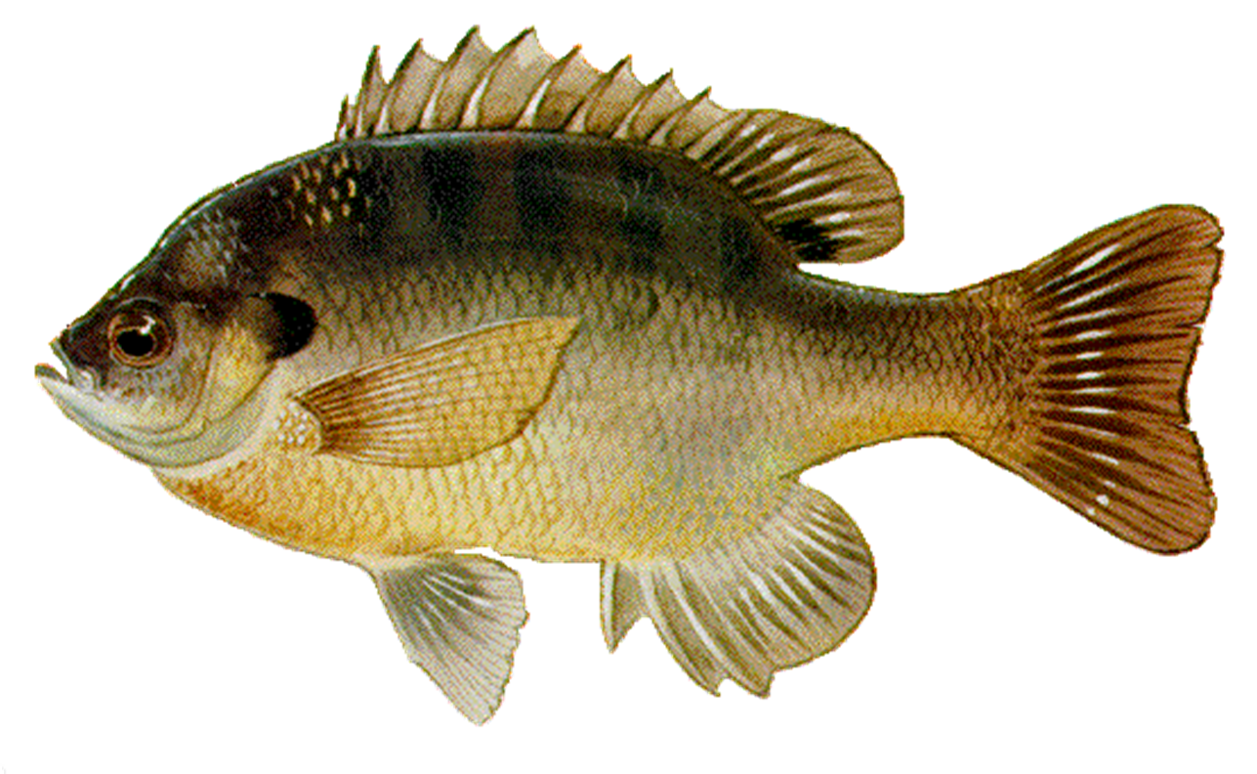
T. maculatus
A. melas
C. venusta
Flash Index
E. gracile
Conductivity
P. vigilax
NH₄⁺
NO₃⁻
Sub-Humid
High Flow
Pulse %
Semi-Arid
Mesic
Dissolved
Oxygen
P. formosa
G. affinis
Precipitation
H. cyanoguttatus
L. macrochirus

Slide 5
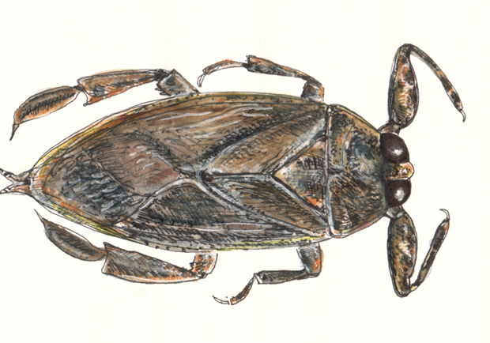
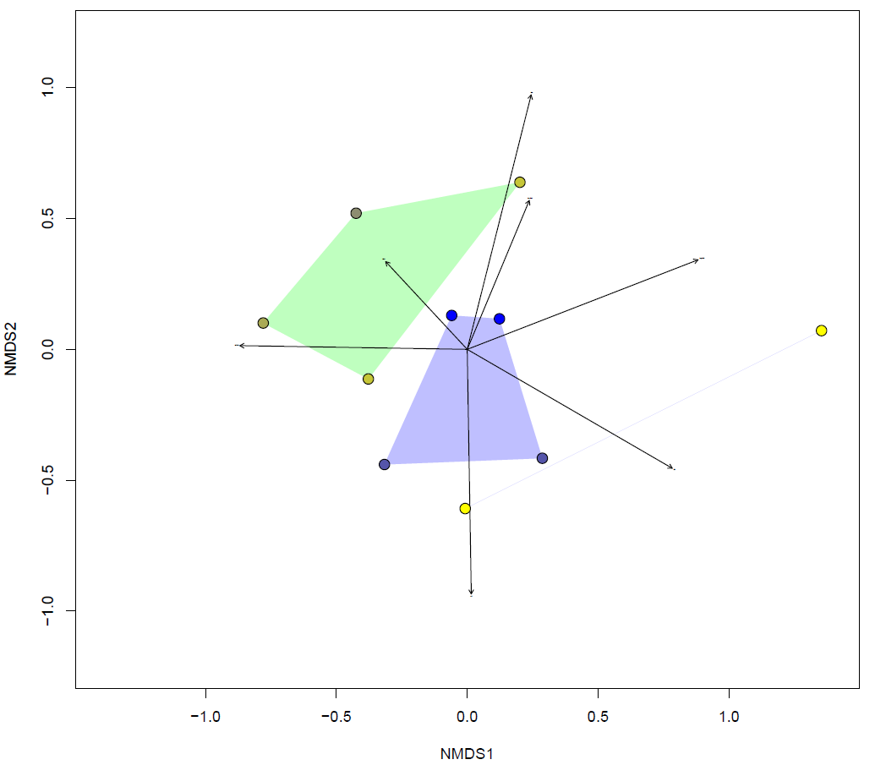
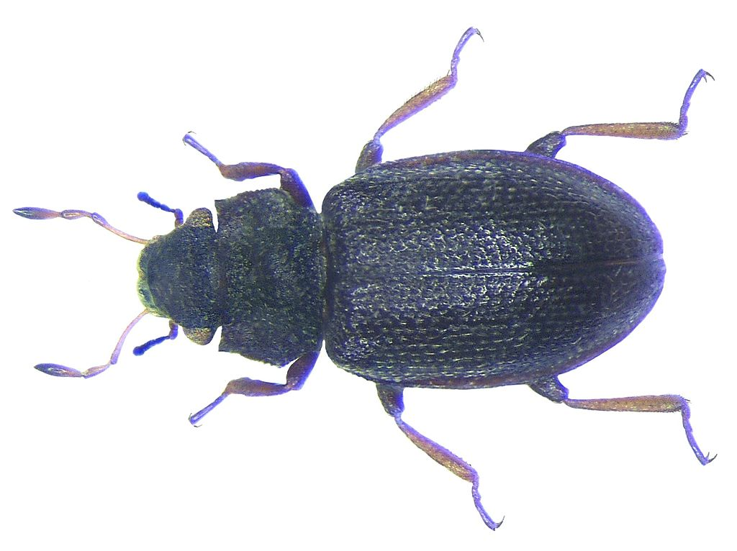
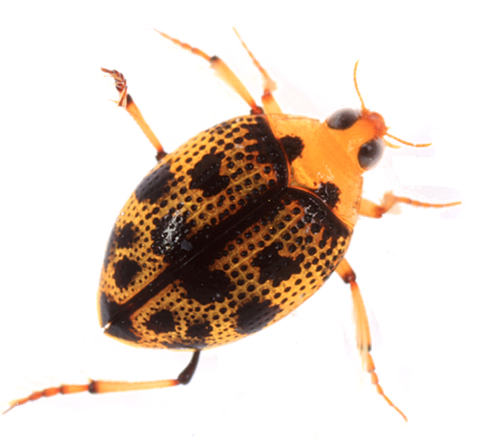
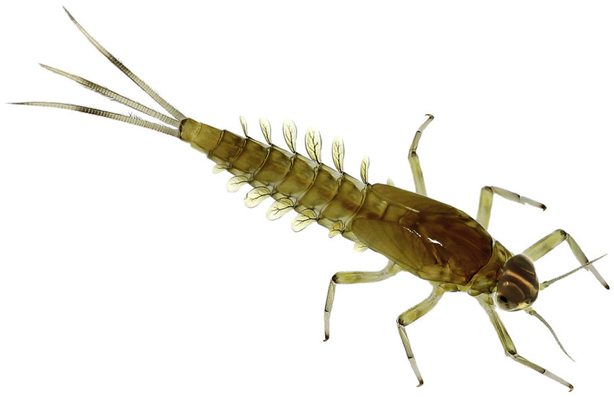
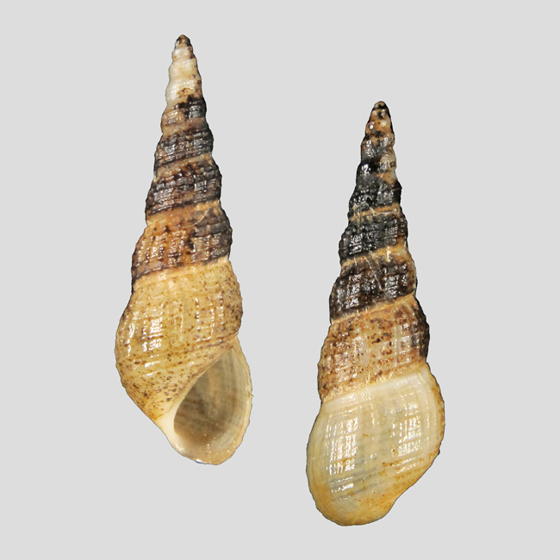
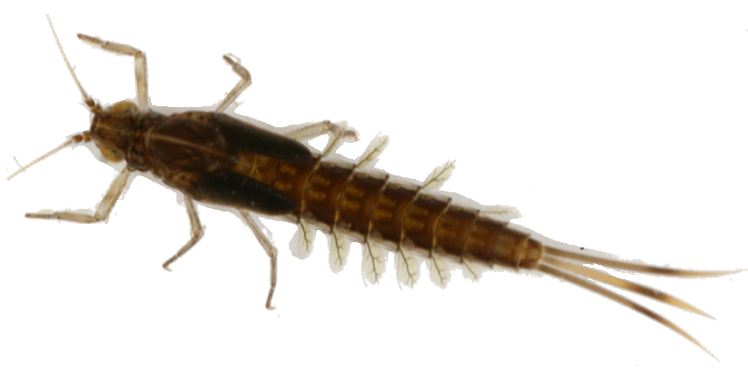
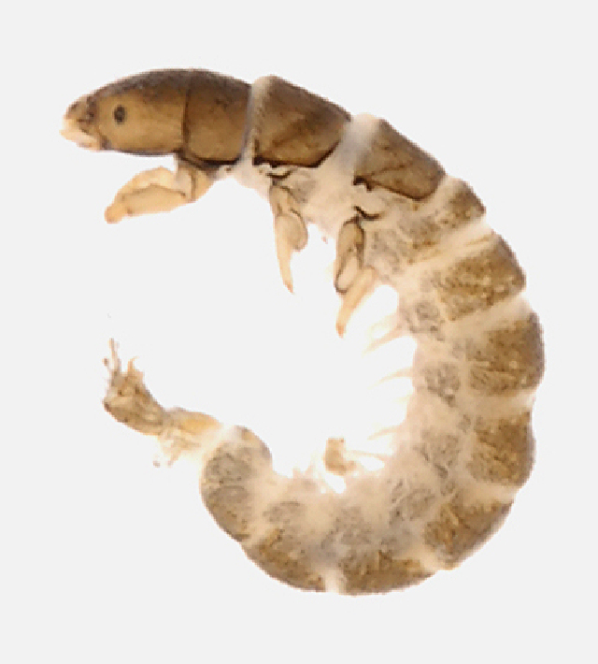
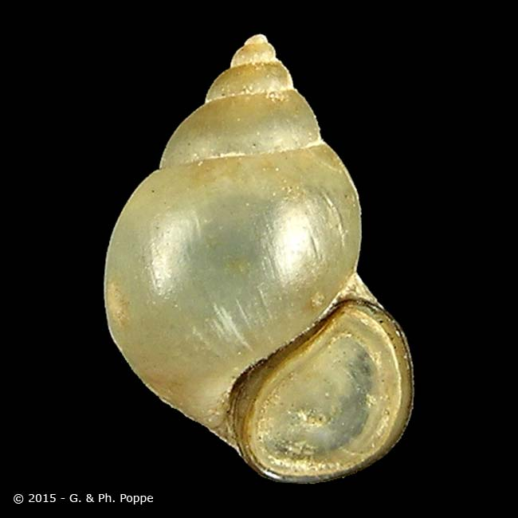
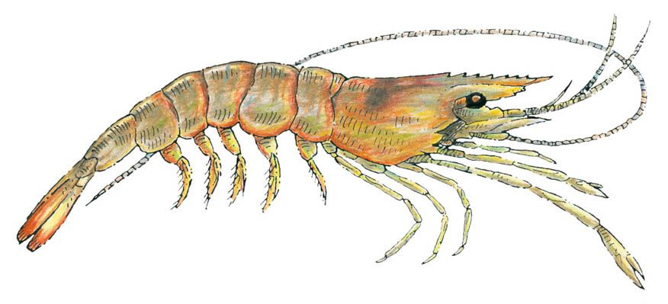
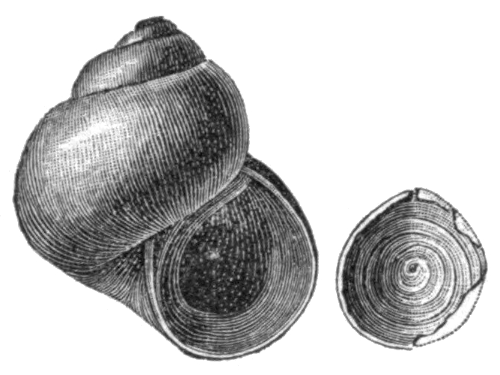
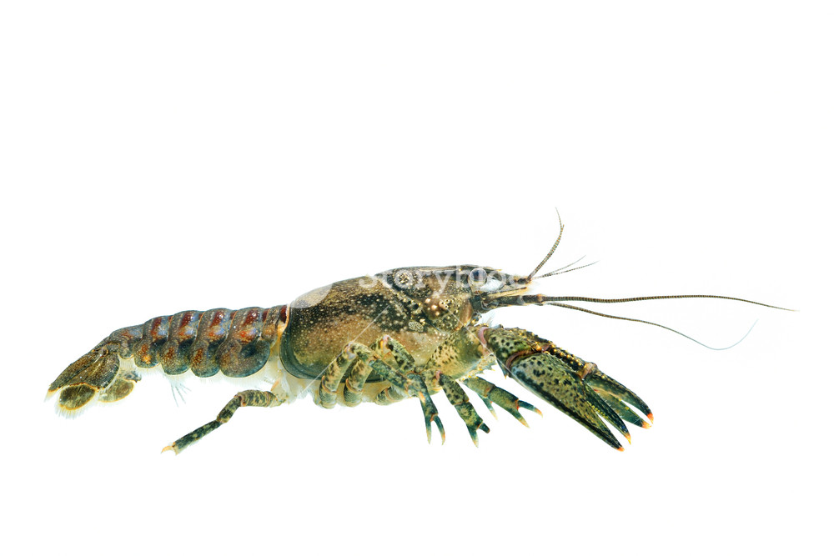
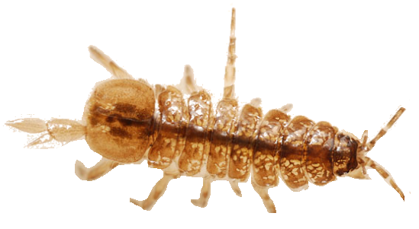
Belostoma
Hydraena
Flash Index
Peltodytes
Fallceon
Conductivity
NH₄⁺
NO₃⁻
Melanoides
Pseudocloeon
Mesic
High Flow
Pulse %
Semi-Arid
Sub-Humid
Dissolved
Oxygen
Smicridea
Bythinia
Palaemonetes
Precipitation
Orconectes
Amnicola
Caecidotea

Slide 7
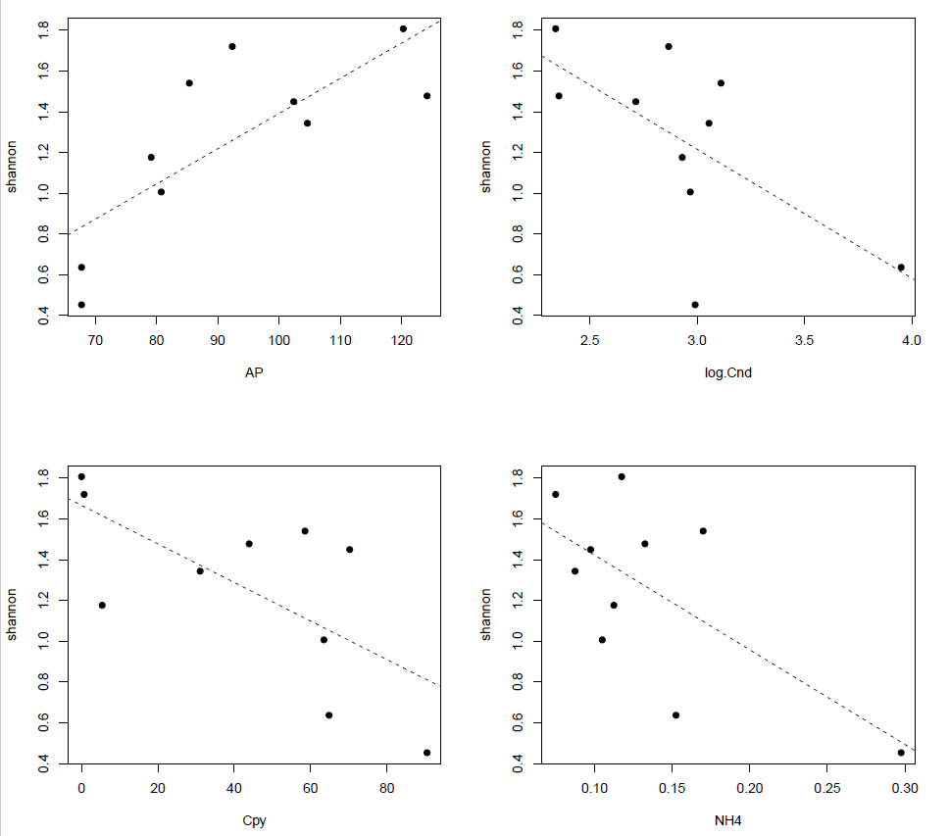
lm(formula = shannon ~ Cpy, data = msterfish)
Residuals:
Min 1Q Median 3Q Max
-0.43929 -0.28301 0.01549 0.20493 0.44739
Coefficients:
Estimate Std. Error t value Pr(>|t|)
(Intercept) 1.666563 0.188380 8.847 2.1e-05 ***
Cpy -0.009456 0.003577 -2.643 0.0296 *
---
Signif. codes: 0 ‘***’ 0.001 ‘**’ 0.01 ‘*’ 0.05 ‘.’ 0.1 ‘ ’ 1
Residual standard error: 0.3457 on 8 degrees of freedom
Multiple R-squared: 0.4662, Adjusted R-squared: 0.3995
F-statistic: 6.988 on 1 and 8 DF, p-value: 0.02956
lm(formula = shannon ~ AP, data = msterfish)
Residuals:
Min 1Q Median 3Q Max
-0.3813 -0.1802 -0.0179 0.1255 0.4609
Coefficients:
Estimate Std. Error t value Pr(>|t|)
(Intercept) -0.335986 0.468696 -0.717 0.49386
AP 0.017271 0.004965 3.479 0.00834 **
---
Signif. codes: 0 ‘***’ 0.001 ‘**’ 0.01 ‘*’ 0.05 ‘.’ 0.1 ‘ ’ 1
Residual standard error: 0.2985 on 8 degrees of freedom
Multiple R-squared: 0.602, Adjusted R-squared: 0.5523
F-statistic: 12.1 on 1 and 8 DF, p-value: 0.008336
lm(formula = shannon ~ NH4, data = msterfish)
Residuals:
Min 1Q Median 3Q Max
-0.54204 -0.17548 -0.01826 0.19991 0.46612
Coefficients:
Estimate Std. Error t value Pr(>|t|)
(Intercept) 1.8873 0.2712 6.959 0.000117 ***
NH4 -4.6474 1.8348 -2.533 0.035093 *
---
Signif. codes: 0 ‘***’ 0.001 ‘**’ 0.01 ‘*’ 0.05 ‘.’ 0.1 ‘ ’ 1
Residual standard error: 0.3525 on 8 degrees of freedom
Multiple R-squared: 0.4451, Adjusted R-squared: 0.3757
F-statistic: 6.416 on 1 and 8 DF, p-value: 0.03509
lm(formula = shannon ~ log.Cnd, data = msterfish)
Residuals:
Min 1Q Median 3Q Max
-0.76882 -0.12964 0.03706 0.17198 0.42050
Coefficients:
Estimate Std. Error t value Pr(>|t|)
(Intercept) 3.1111 0.7999 3.890 0.00461 **
log.Cnd -0.6318 0.2703 -2.337 0.04760 *
---
Signif. codes: 0 ‘***’ 0.001 ‘**’ 0.01 ‘*’ 0.05 ‘.’ 0.1 ‘ ’ 1
Residual standard error: 0.3648 on 8 degrees of freedom
Multiple R-squared: 0.4058, Adjusted R-squared: 0.3315
F-statistic: 5.464 on 1 and 8 DF, p-value: 0.0476

Slide 8
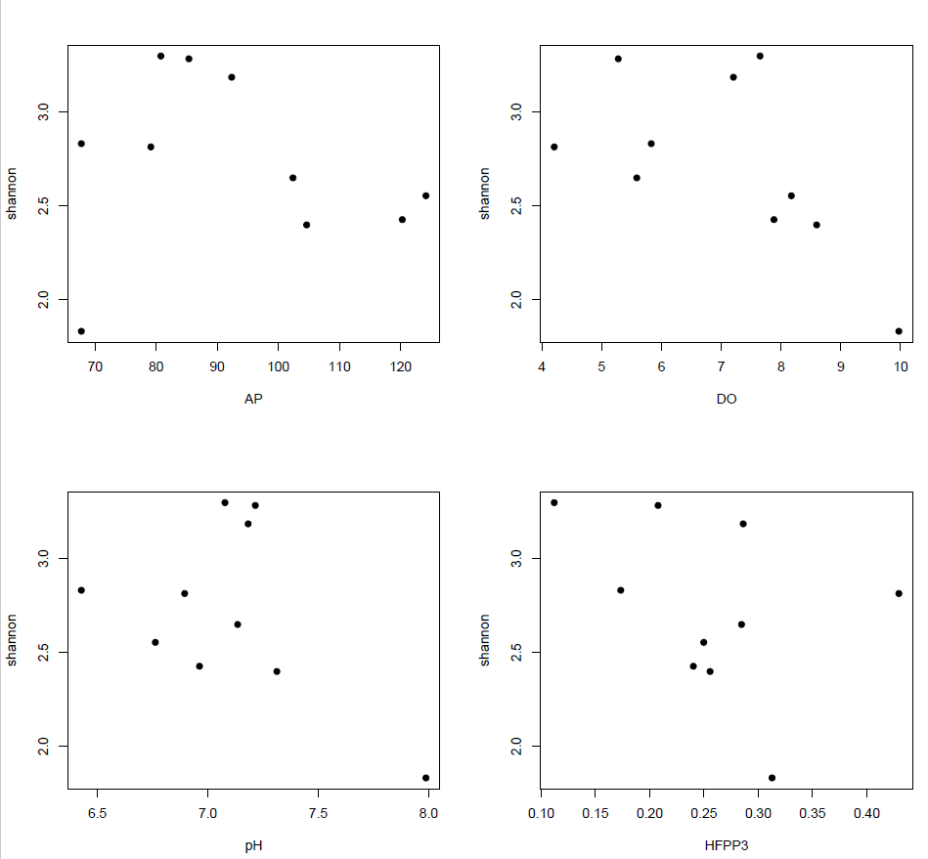
lm(formula = shannon ~ AP, data = msterinvert)
Residuals:
Min 1Q Median 3Q Max
-0.97021 -0.18173 -0.00931 0.35495 0.53578
Coefficients:
Estimate Std. Error t value Pr(>|t|)
(Intercept) 3.005858 0.758449 3.963 0.00416 **
AP -0.003020 0.008034 -0.376 0.71673
---
Signif. codes: 0 ‘***’ 0.001 ‘**’ 0.01 ‘*’ 0.05 ‘.’ 0.1 ‘ ’ 1
Residual standard error: 0.4831 on 8 degrees of freedom
Multiple R-squared: 0.01736, Adjusted R-squared: -0.1055
F-statistic: 0.1413 on 1 and 8 DF, p-value: 0.7167
lm(formula = shannon ~ pH, data = msterinvert)
Residuals:
Min 1Q Median 3Q Max
-0.4342 -0.3197 -0.1372 0.3729 0.6178
Coefficients:
Estimate Std. Error t value Pr(>|t|)
(Intercept) 6.3977 2.5311 2.528 0.0354 *
pH -0.5174 0.3562 -1.453 0.1844
---
Signif. codes: 0 ‘***’ 0.001 ‘**’ 0.01 ‘*’ 0.05 ‘.’ 0.1 ‘ ’ 1
Residual standard error: 0.4335 on 8 degrees of freedom
Multiple R-squared: 0.2087, Adjusted R-squared: 0.1098
F-statistic: 2.11 on 1 and 8 DF, p-value: 0.1844
lm(formula = shannon ~ HFPP3, data = msterinvert)
Residuals:
Min 1Q Median 3Q Max
-0.77560 -0.29193 -0.04161 0.40579 0.52263
Coefficients:
Estimate Std. Error t value Pr(>|t|)
(Intercept) 3.2582 0.4711 6.916 0.000122 ***
HFPP3 -2.0832 1.7599 -1.184 0.270518
---
Signif. codes: 0 ‘***’ 0.001 ‘**’ 0.01 ‘*’ 0.05 ‘.’ 0.1 ‘ ’ 1
Residual standard error: 0.4496 on 8 degrees of freedom
Multiple R-squared: 0.149, Adjusted R-squared: 0.04266
F-statistic: 1.401 on 1 and 8 DF, p-value: 0.2705
lm(formula = shannon ~ DO, data = msterinvert)
Residuals:
Min 1Q Median 3Q Max
-0.43624 -0.27098 -0.08482 0.21151 0.66684
Coefficients:
Estimate Std. Error t value Pr(>|t|)
(Intercept) 3.82810 0.53072 7.213 9.13e-05 ***
DO -0.15653 0.07336 -2.134 0.0654 .
---
Signif. codes: 0 ‘***’ 0.001 ‘**’ 0.01 ‘*’ 0.05 ‘.’ 0.1 ‘ ’ 1
Residual standard error: 0.3891 on 8 degrees of freedom
Multiple R-squared: 0.3627, Adjusted R-squared: 0.283
F-statistic: 4.553 on 1 and 8 DF, p-value: 0.06542

Slide 9
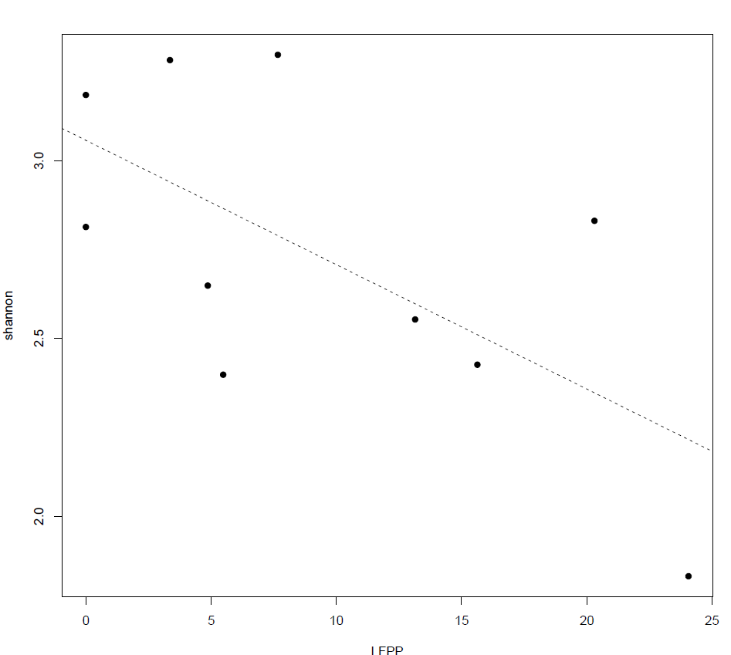
lm(formula = shannon ~ LFPP, data = msterinvert)
Residuals:
Min 1Q Median 3Q Max
-0.46752 -0.24249 -0.06424 0.28907 0.50858
Coefficients:
Estimate Std. Error t value Pr(>|t|)
(Intercept) 3.05718 0.18311 16.696 1.68e-07 ***
LFPP -0.03498 0.01479 -2.365 0.0456 *
---
Signif. codes: 0 ‘***’ 0.001 ‘**’ 0.01 ‘*’ 0.05 ‘.’ 0.1 ‘ ’ 1
Residual standard error: 0.3739 on 8 degrees of freedom
Multiple R-squared: 0.4114, Adjusted R-squared: 0.3378
F-statistic: 5.592 on 1 and 8 DF, p-value: 0.04563

Slide 10
Fish Rank 1 dredge:
lm(formula = shannon ~ AP + LFPP, data = msterfish)
Residuals:
Min 1Q Median 3Q Max
-0.20628 -0.14339 -0.09649 0.20022 0.26589
Coefficients:
Estimate Std. Error t value Pr(>|t|)
(Intercept) 0.054010 0.365464 0.148 0.88668
AP 0.015598 0.003641 4.284 0.00364 **
LFPP -0.024900 0.008663 -2.874 0.02385 *
---
Signif. codes: 0 ‘***’ 0.001 ‘**’ 0.01 ‘*’ 0.05 ‘.’ 0.1 ‘ ’ 1
Residual standard error: 0.2162 on 7 degrees of freedom
Multiple R-squared: 0.8175, Adjusted R-squared: 0.7653
F-statistic: 15.67 on 2 and 7 DF, p-value: 0.002599
> vif(rank1.fish.dredge) # p-value: 0.002599
AP LFPP
1.026206 1.026206
Fish Rank 3 dredge:
lm(formula = shannon ~ AP + Cpy, data = msterfish)
Residuals:
Min 1Q Median 3Q Max
-0.20776 -0.16631 -0.09763 0.16604 0.46338
Coefficients:
Estimate Std. Error t value Pr(>|t|)
(Intercept) 0.299779 0.517638 0.579 0.5807
AP 0.013090 0.004773 2.742 0.0288 *
Cpy -0.005809 0.002970 -1.956 0.0913 .
---
Signif. codes: 0 ‘***’ 0.001 ‘**’ 0.01 ‘*’ 0.05 ‘.’ 0.1 ‘ ’ 1
Residual standard error: 0.2566 on 7 degrees of freedom
Multiple R-squared: 0.7427, Adjusted R-squared: 0.6692
F-statistic: 10.1 on 2 and 7 DF, p-value: 0.008642
> vif(rank3.fish.dredge) # p-value: 0.008642
AP Cpy
1.250853 1.250853
Fish Rank 4 dredge:
lm(formula = shannon ~ AP + NH4, data = msterfish)
Residuals:
Min 1Q Median 3Q Max
-0.2515 -0.1978 -0.0454 0.1080 0.4668
Coefficients:
Estimate Std. Error t value Pr(>|t|)
(Intercept) 0.401516 0.614655 0.653 0.5345
AP 0.013176 0.005129 2.569 0.0371 *
NH4 -2.663321 1.605296 -1.659 0.1411
---
Signif. codes: 0 ‘***’ 0.001 ‘**’ 0.01 ‘*’ 0.05 ‘.’ 0.1 ‘ ’ 1
Residual standard error: 0.2704 on 7 degrees of freedom
Multiple R-squared: 0.7143, Adjusted R-squared: 0.6327
F-statistic: 8.752 on 2 and 7 DF, p-value: 0.01246
> vif(rank4.fish.dredge) # p-value: 0.01246
AP NH4
1.301233 1.301233
Fish Rank 2 dredge:
lm(formula = shannon ~ AP, data = msterfish)
Residuals:
Min 1Q Median 3Q Max
-0.3813 -0.1802 -0.0179 0.1255 0.4609
Coefficients:
Estimate Std. Error t value Pr(>|t|)
(Intercept) -0.335986 0.468696 -0.717 0.49386
AP 0.017271 0.004965 3.479 0.00834 **
---
Signif. codes: 0 ‘***’ 0.001 ‘**’ 0.01 ‘*’ 0.05 ‘.’ 0.1 ‘ ’ 1
Residual standard error: 0.2985 on 8 degrees of freedom
Multiple R-squared: 0.602, Adjusted R-squared: 0.5523
F-statistic: 12.1 on 1 and 8 DF, p-value: 0.008336

Slide 11
Invert Rank 1 dredge:
lm(formula = shannon ~ HFPP3 + LFPP, data = msterinvert)
Residuals:
Min 1Q Median 3Q Max
-0.49983 -0.07876 0.00191 0.14460 0.31336
Coefficients:
Estimate Std. Error t value Pr(>|t|)
(Intercept) 3.95689 0.32810 12.060 6.15e-06 ***
HFPP3 -3.21078 1.07532 -2.986 0.02034 *
LFPP -0.04349 0.01087 -4.001 0.00518 **
---
Signif. codes: 0 ‘***’ 0.001 ‘**’ 0.01 ‘*’ 0.05 ‘.’ 0.1 ‘ ’ 1
Residual standard error: 0.2651 on 7 degrees of freedom
Multiple R-squared: 0.7411, Adjusted R-squared: 0.6672
F-statistic: 10.02 on 2 and 7 DF, p-value: 0.008828
> vif(rank1.invert.dredge) # p-value: 0.008828
HFPP3 LFPP
1.073745 1.073745
Inver Rank 3 dredge:
lm(formula = shannon ~ DO + HFPP3 + LFPP, data = msterinvert)
Residuals:
Min 1Q Median 3Q Max
-0.28360 -0.04584 0.04263 0.07263 0.28411
Coefficients:
Estimate Std. Error t value Pr(>|t|)
(Intercept) 4.64023 0.40150 11.557 2.52e-05 ***
DO -0.10774 0.04805 -2.242 0.06614 .
HFPP3 -3.36722 0.85956 -3.917 0.00783 **
LFPP -0.03134 0.01021 -3.069 0.02196 *
---
Signif. codes: 0 ‘***’ 0.001 ‘**’ 0.01 ‘*’ 0.05 ‘.’ 0.1 ‘ ’ 1
Residual standard error: 0.2112 on 6 degrees of freedom
Multiple R-squared: 0.8592, Adjusted R-squared: 0.7887
F-statistic: 12.2 on 3 and 6 DF, p-value: 0.00578
> vif(rank3.invert.dredge) # p-value: 0.00578
DO HFPP3 LFPP
1.455665 1.080867 1.493627
Invert Rank 4 dredge:
lm(formula = shannon ~ DO, data = msterinvert)
Residuals:
Min 1Q Median 3Q Max
-0.43624 -0.27098 -0.08482 0.21151 0.66684
Coefficients:
Estimate Std. Error t value Pr(>|t|)
(Intercept) 3.82810 0.53072 7.213 9.13e-05 ***
DO -0.15653 0.07336 -2.134 0.0654 .
---
Signif. codes: 0 ‘***’ 0.001 ‘**’ 0.01 ‘*’ 0.05 ‘.’ 0.1 ‘ ’ 1
Residual standard error: 0.3891 on 8 degrees of freedom
Multiple R-squared: 0.3627, Adjusted R-squared: 0.283
F-statistic: 4.553 on 1 and 8 DF, p-value: 0.06542
Invert Rank 2 dredge:
lm(formula = shannon ~ LFPP, data = msterinvert)
Residuals:
Min 1Q Median 3Q Max
-0.46752 -0.24249 -0.06424 0.28907 0.50858
Coefficients:
Estimate Std. Error t value Pr(>|t|)
(Intercept) 3.05718 0.18311 16.696 1.68e-07 ***
LFPP -0.03498 0.01479 -2.365 0.0456 *
---
Signif. codes: 0 ‘***’ 0.001 ‘**’ 0.01 ‘*’ 0.05 ‘.’ 0.1 ‘ ’ 1
Residual standard error: 0.3739 on 8 degrees of freedom
Multiple R-squared: 0.4114, Adjusted R-squared: 0.3378
F-statistic: 5.592 on 1 and 8 DF, p-value: 0.04563

